Slide 1
Business Intelligence System for Global Sales Analysis and Customer Segmentation
Project Progress Report
[AT 82 - DSAI] Business Intelligence and Analytics (BI&A)
Presented by Group 7:
Nathas Sungworawongpana (st124323),
Wut Yee Aung (st124377),
Kyi Thin Nu (st124087)
23. March. 2024 (Saturday)

Slide 2
Application Domain
Business Intelligence System for Global Sales Data Analysis
Decision Support System for the Customer Segmentation

Slide 3
Objective
Analyzing sales data across multiple countries.
Creating an interactive BI dashboard for real-time insights.
Implementing a Decision Support System (DSS) for customer segmentation.
Enhancing overall business intelligence for informed decision-making

Slide 4
Progress
Analyzing sales data across multiple countries.
Creating an interactive BI dashboard for real-time insights.

Slide 5
Description
For the data sources, we will use the dataset that is provided from the paper, “Online Retail Dataset II (Chongkolnee R. et. al. (2023))”.
The dataset contains 2 years of sales data (Year 2009-2010 and Year 2010-2011) including total 1067371 samples and 8 features.
Features:
Invoice
Stock Code
Description
Quantity
InvoiceDate
Price
CustomerID
Country
Data Source

Slide 6
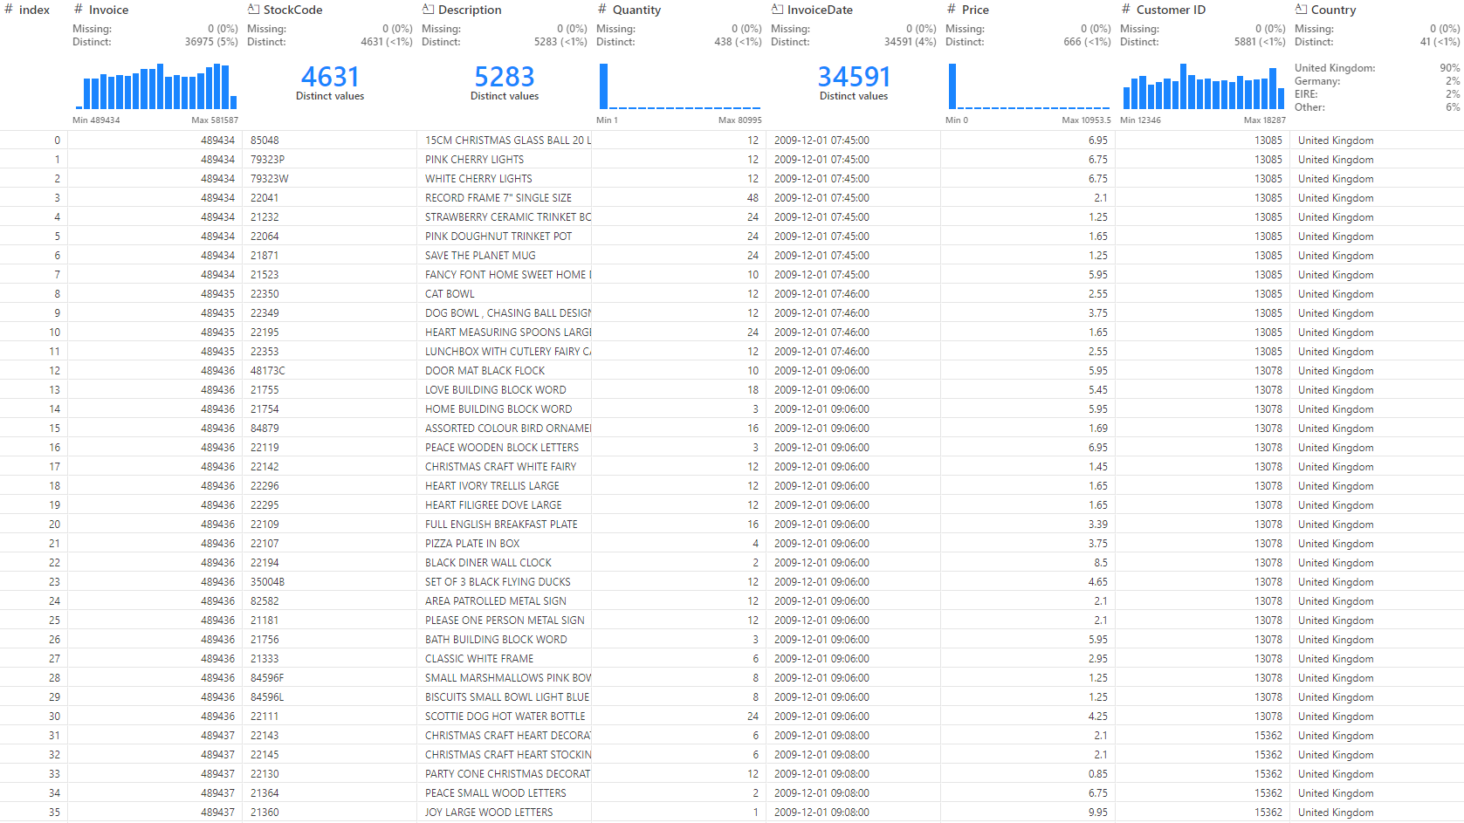

Slide 7
Description
For BI dashboard,
Analyze historical data and define key metrics to answer ‘what’ and ‘how’ of past business operations and performance.
Extract and prepare data for the key metrics from datasets.
Develop the periodical reports and Key Performance dashboard with Tableau.
Methodology

Slide 8
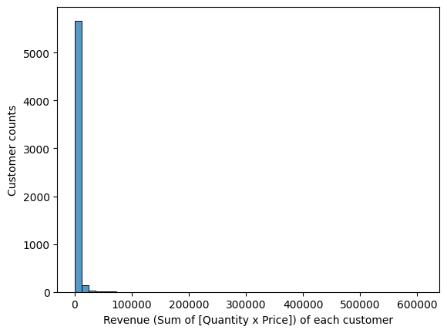
Description
Customer Segmentation
According to Chongkolnee R. et. al. (2023)†, the authors quantify customers’ purchasing amount, purchasing frequency, and time since last purchase into quantiles and segment customers based on that. The issue is the heavily skewed nature of the data, which distorts the edge quantiles. Specifically, in heavily right-skewed distributions, the edge quantiles cover an excessively wide range, rendering their qualitative information practically meaningless. To fix this, we propose to make a scoring based on the standard deviation instead.
Methodology

Slide 9
Methodology

Slide 10
BI Dashboard
max growth
Customer Segmentation Dashboard
Sales Performance Dashboard
Customer Dashboard

Slide 11
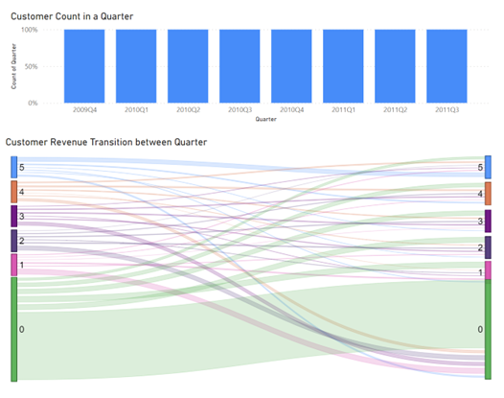
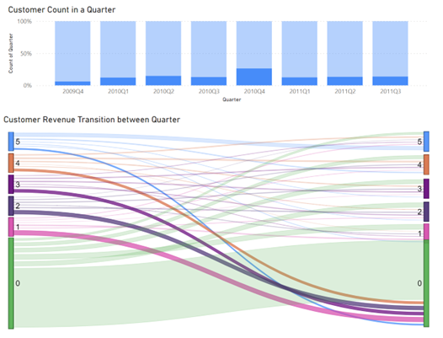
Customer Segmentation Dashboard
max growth
Customer Segmentation according to revenue from each customer. Score 0 is for non-purchaser in a quarter and Score 1-5 is given based on percentiles of revenue.
Customer retention rate
Customer churning rate
Customer comeback rate
Customer increasing/decreasing purchase

Slide 12
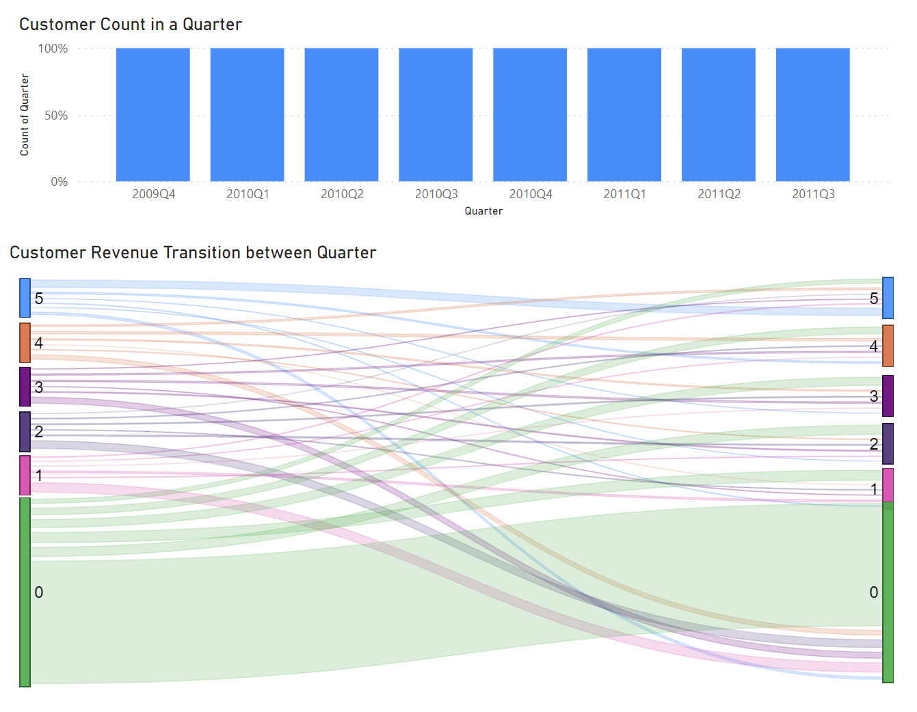

Slide 13
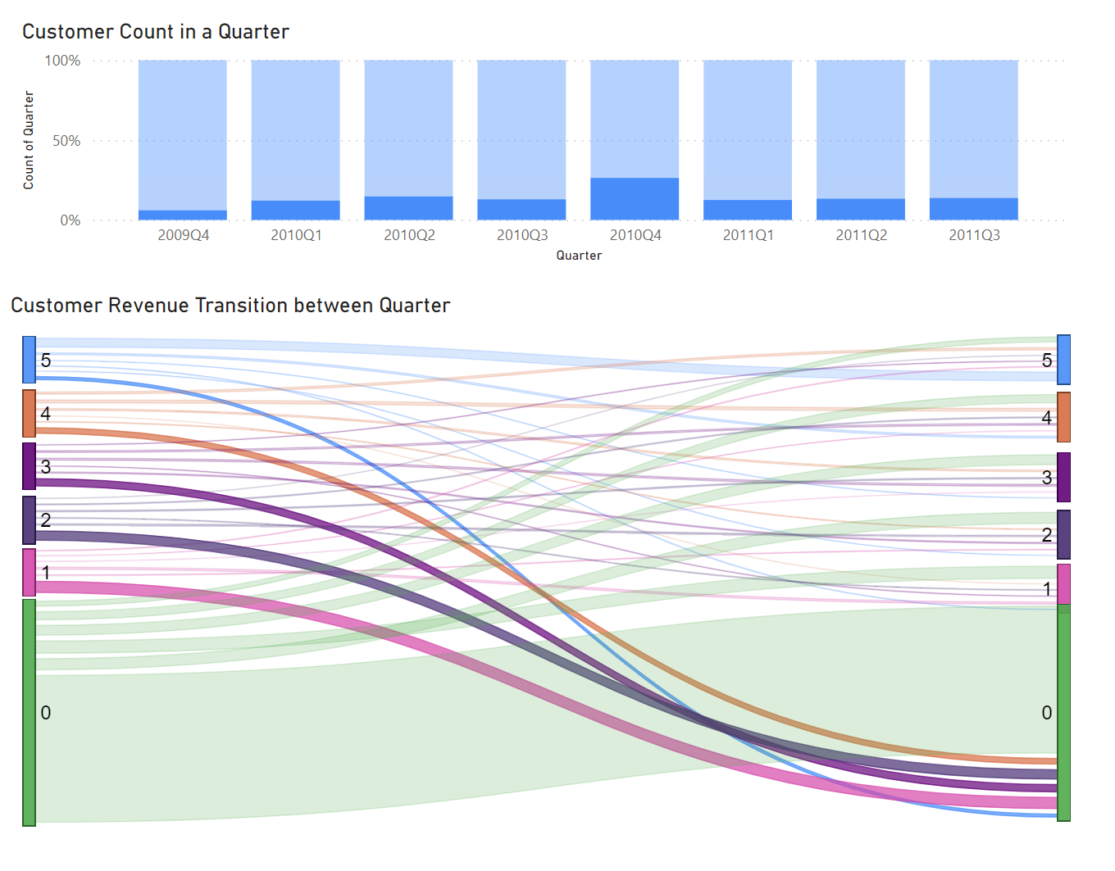

Slide 15
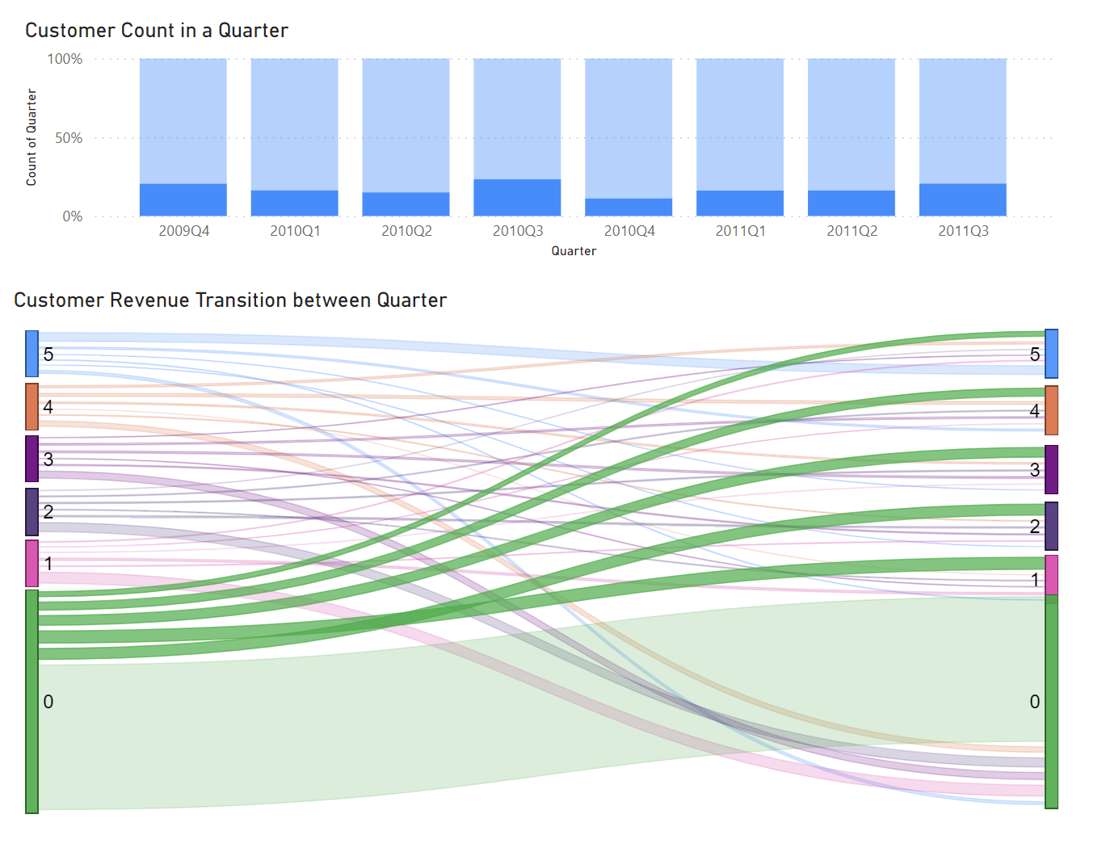

Slide 16
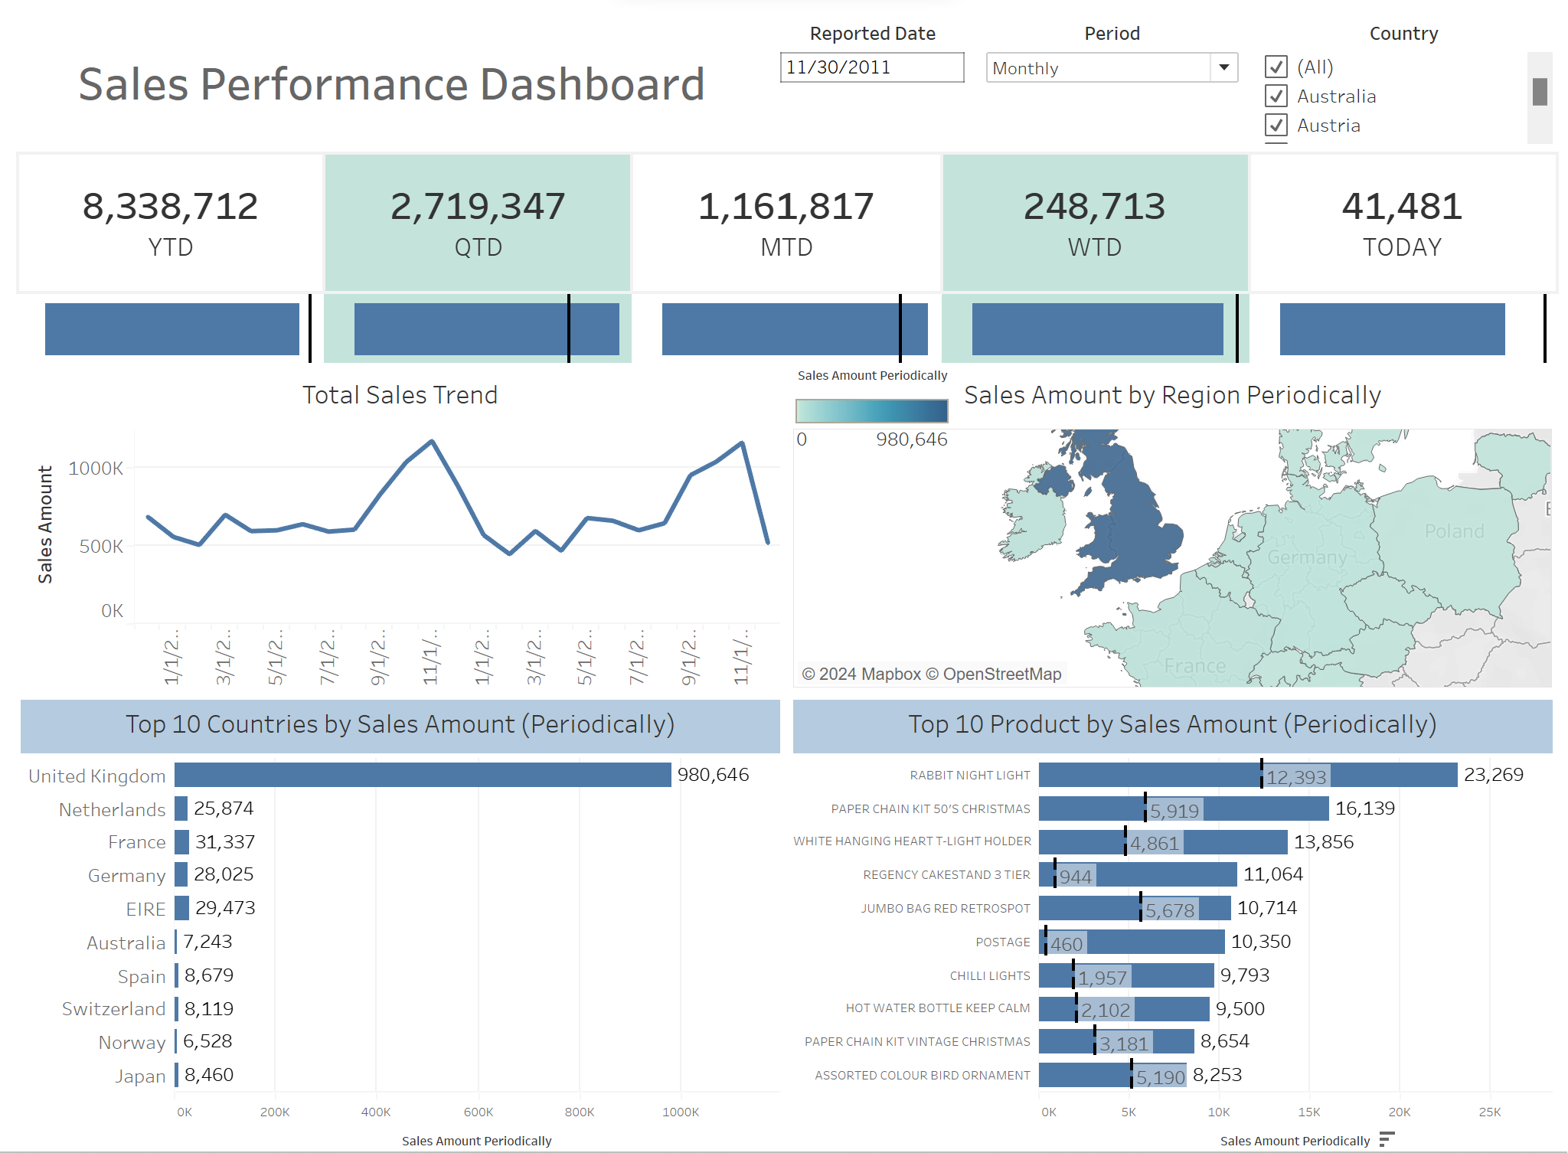
Sales Performance Dashboard
max growth
Sales amount KPI according to selected date, period and region
Total sales amount
Sales Trend
Sales by region
Top 10 countries by sales amount
Top 10 product by sales amount

Slide 18
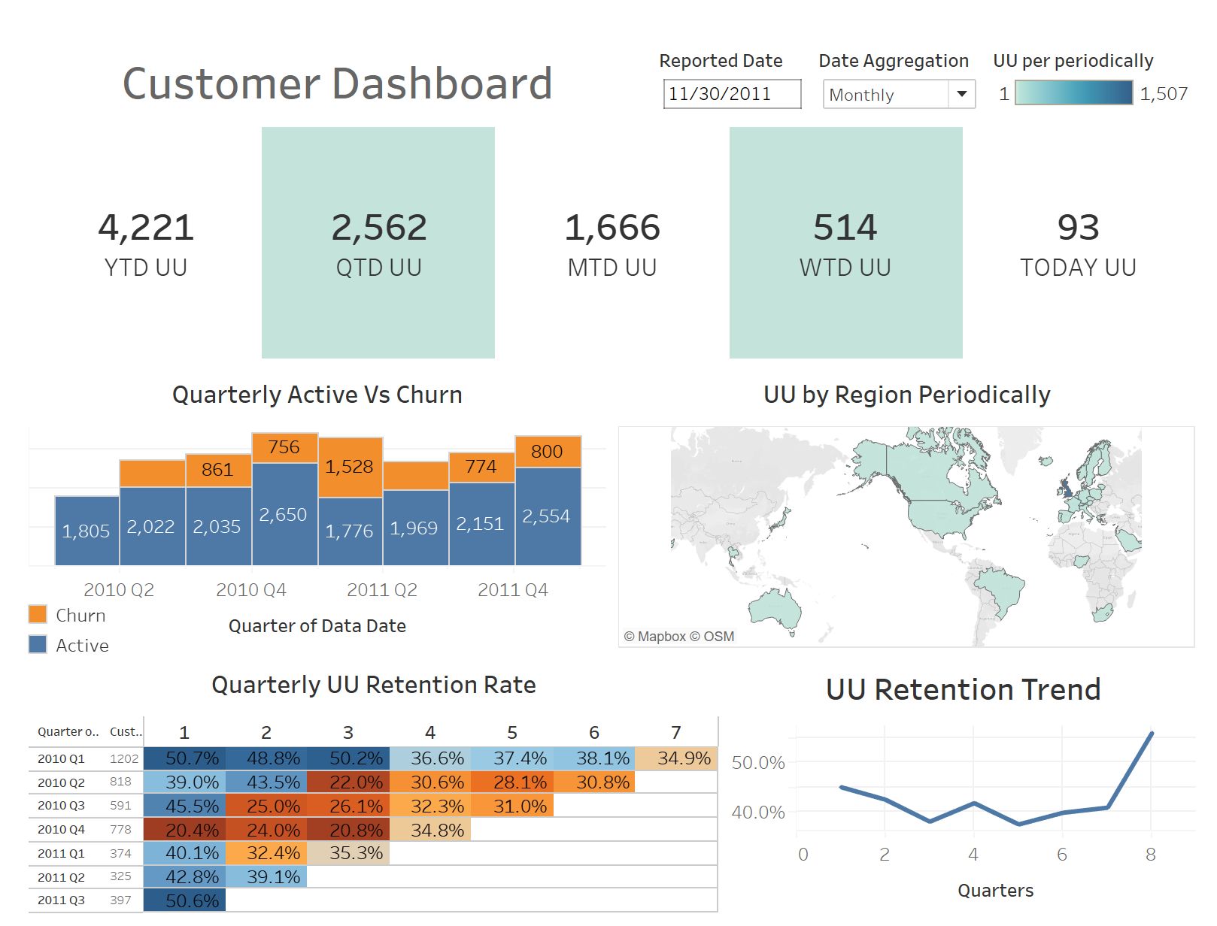
Customer Dashboard
max growth
Customer KPI according to selected date and period
Active user count
Quarterly Active vs Churn
Customer by region
Customer retention rate
Customer retention trend

Slide 20
Conclusion
BI system can provide either traditional or interactive reporting to assist organization in decision making.
Enables the analysis of historical data to address business questions.
Descriptive, Predictive and Prescriptive analysis support data-driven decision-making system.

Slide 21
Thank You

